Slide 1
Chapter 1: Introduction
BIT 3103 Computer Operating Systems

Slide 2
Overview
What Operating Systems Do
Computer-System Organization
Functions of Operating System

Slide 3
Objectives
To provide a grand tour of the major operating systems components
To provide coverage of basic computer system organization

Slide 4
What is an Operating System?
A system software program which manage and control computer resources
Provides user with a virtual machine

Slide 5
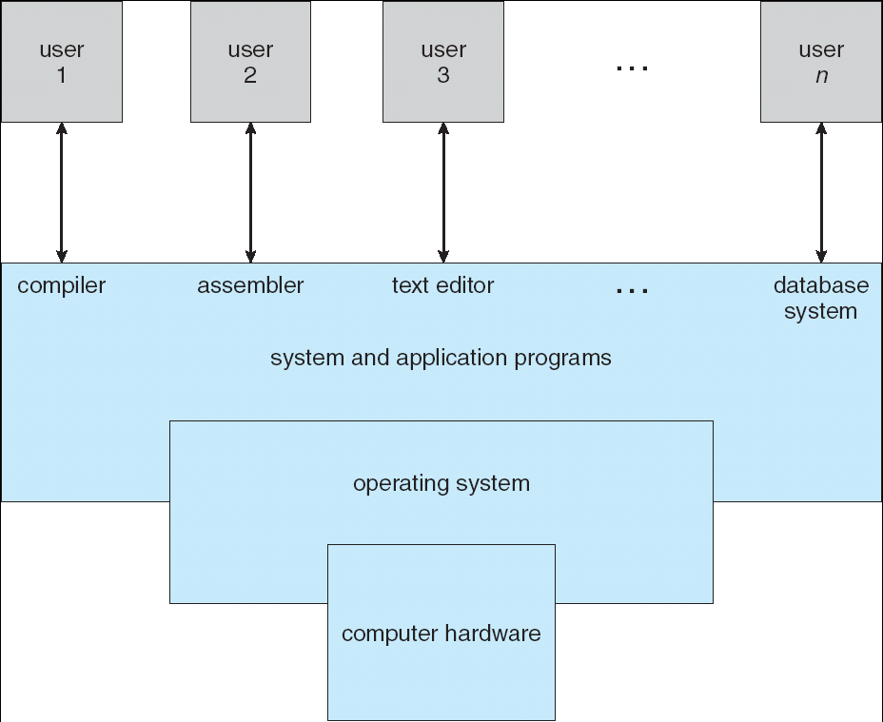
The Components of a Computer System

Slide 6
Operating System Definition
OS is a resource allocator
Manages all resources
Decides between conflicting requests for efficient and fair resource use
OS is a control program
Controls execution of programs to prevent errors and improper use of the computer

Slide 7
Layered Approach
The operating system is divided into a number of layers (levels), each built on top of lower layers. The bottom layer (layer 0), interfaces with the hardware; the highest (layer N) interfaces the user interface.
With modularity, layers are selected such that each uses functions (operations) and services of only lower-level layers

Slide 8
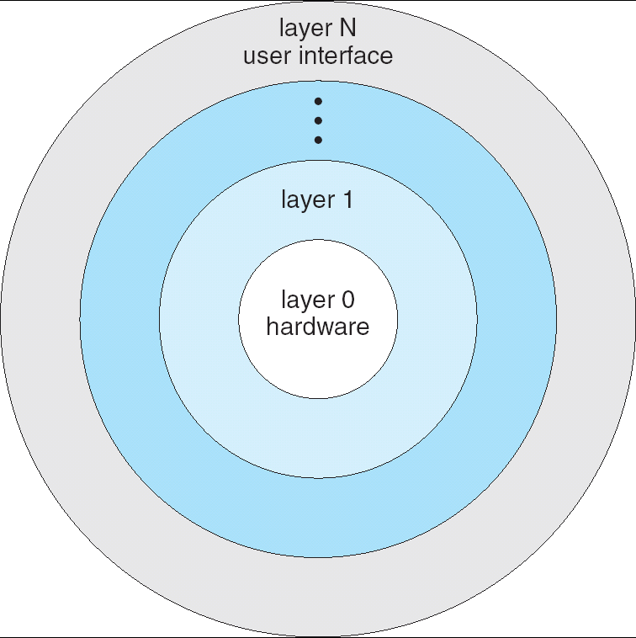
Layered Operating System

Slide 9
Computer Startup
bootstrap program is loaded at power-up or reboot
Typically stored in ROM or EEPROM, generally known as firmware
Initializates all aspects of system
Loads operating system kernel and starts execution

Slide 10
Computer System Organization
Computer-system operation
One or more CPUs, device controllers connect through common bus providing access to shared memory
Concurrent execution of CPUs and devices competing for memory cycles

Slide 11
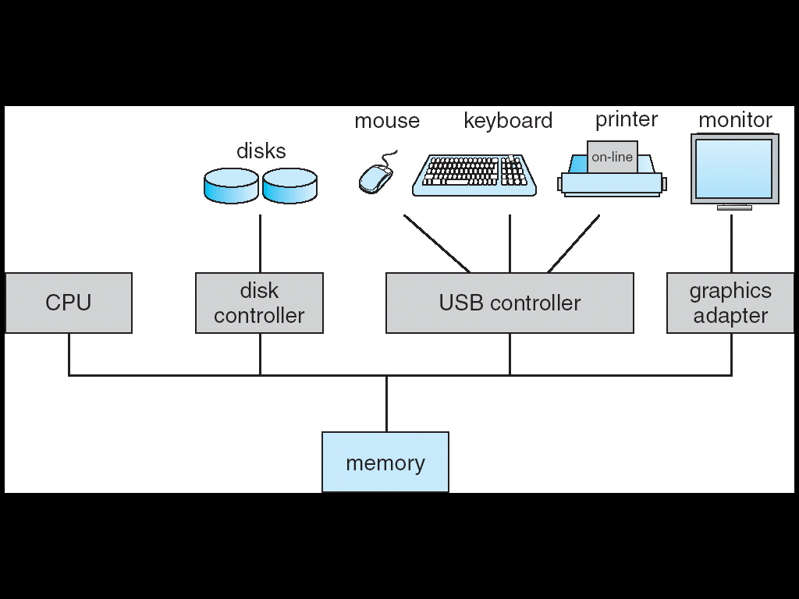
Computer System Organization

Slide 12
Examples of operating systems
Microsoft family – MS- DOS, Windows 95, windows 98, windows NT …..
Unix
Linux
Ubuntu
etc

Slide 13
Features of OS
Explain the following features of an OS
Multiprogramming
Multiprocessing
Timesharing
Multitasking
Virtual Memory concept

Slide 14
Functions of an operating System
Provision of User interface
Command language interface
Graphical user interface
Process Scheduling – determine which process to execute next
I/o Handling
Resource allocation and accounting

Slide 15
Resource allocation and accounting
Resource allocation - When multiple users or multiple jobs running concurrently, resources must be allocated to each of them
Accounting - To keep track of which users use how much and what kinds of computer resources

Slide 16
Interrupt handling
Network (Communication) control - – Processes may exchange information, on the same computer or between computers over a network
Error Handling - Error detection – OS needs to be constantly aware of possible errors
May occur in the CPU and memory hardware, in I/O devices, in user program
For each type of error, OS should take the appropriate action to ensure correct and consistent computing
Debugging facilities can greatly enhance the user’s and programmer’s abilities to efficiently use the system

Slide 17
Memory Management
All data in memory before and after processing
All instructions in memory in order to execute
Memory management determines what is in memory when
Optimizing CPU utilization and computer response to users
Memory management activities
Keeping track of which parts of memory are currently being used and by whom
Deciding which processes (or parts thereof) and data to move into and out of memory
Allocating and deallocating memory space as needed

Slide 18
Storage Management
OS provides uniform, logical view of information storage
Abstracts physical properties to logical storage unit - filesystem
Each medium is controlled by device (i.e., disk drive, tape drive)
Varying properties include access speed, capacity, data-transfer rate, access method (sequential or random)
File-System management
Files usually organized into directories
Access control on most systems to determine who can access what
OS activities include
Creating and deleting files and directories
Primitives to manipulate files and dirs
Mapping files onto secondary storage
Backup files onto stable (non-volatile) storage media

Slide 19
Protection and Security
Protection – any mechanism for controlling access of processes or users to resources defined by the OS
Security – defense of the system against internal and external attacks
Huge range, including denial-of-service, worms, viruses, identity theft, theft of service
Systems generally first distinguish among users, to determine who can do what
User identities (user IDs, security IDs) include name and associated number, one per user
User ID then associated with all files, processes of that user to determine access control
Group identifier (group ID) allows set of users to be defined and controls managed, then also associated with each process, file
Privilege escalation allows user to change to effective ID with more rights

